Slide 1
CS6907-12: Big Data and Analytics
Spring 2016
Stephen H. Kaisler, D.Sc.
Lecture 0 -Administrivia

Slide 2

Contact Me
Adjunct Prof. Stephen H. Kaisler, D.Sc.
H: 301-498-4244
C: 240-593-0980
email: skaisler1@comcast.net
It is best to contact me via email during the day as I may not always have access to my cell phone.
You may leave a voice mail and I will try to call you back at the
earliest opportunity.
Teachers open the door.
You enter by yourself.
- Chinese Proverb –
CSCI 6907-13: Big Data and Analytics

Slide 3
Purpose
To introduce students to some of the concepts, issues and challenges in dealing with Big Data
To examine the types of analytics and work with a few of the tools to process some relatively Big Data sets.
To understand the type of advanced analytics beyond simple statistical analysis, data mining, and statistical machine learning which address complex problems facing business, society, science and engineering today.
To describe the roles of data scientist and analytic scientist
CSCI 6907-13: Big Data and Analytics

Slide 4
Course Requirements
This course consists of a term paper, several class projects, and a final exam.
1. Class Projects 50%
I. 10%
II. 15%
III 25%
2. Term Paper 25%
3. Final Exam (2 Hours) 25%
Total 100%
Prerequisites: Programming and Data structures, Discrete Math, and a basic knowledge of ideas in abstraction, algorithms, etc..
  You will be programming in R; you should have had at least one programming course (preferably Java)
CSCI 6907-13: Big Data and Analytics

Slide 5
Textbooks
Required:
Rampolla, M.L. 2014. A Short Guide to Writing in History, 8th. Ed. St. Martin’s Press 0312403577
Optional:
Data Science Book (posted to Blackboard)
Note: Rampolla’s book contains the rules for writing good term papers. I have used it for over 16 years through various editions. I may ask a question from this book on the final exam. When I grade your term papers for spelling, usage, structure, etc., I will be using Rampolla as the key reference. So, I strongly recommend that you buy this book and read it. There is NO excuse for a poorly written paper at the Graduate Level!!
CSCI 6907-13: Big Data and Analytics

Slide 6
Class Notes
There will be class handouts provided every week. These will be posted to the class Blackboard site.
The final exam will be drawn from the class notes, the lectures, and the readings.
The class notes will serve as an outline, but I will provide additional material during the lectures.
Therefore, it is incumbent upon you to attend every lecture (unless you are ill or on travel for your job) or to obtain class notes from someone who was physically present (and, hopefully, awake).
CSCI 6907-13: Big Data and Analytics

Slide 7
Additional Reading
The additional books on Blackboard are supplemental to the lectures. You should read for absorption and understanding, not for regurgitation.
Substantial additional reading is required. These papers will be posted to the class Blackboard site.
Others, you will have to access for yourself at URLs or through reading articles in technical journals in the library.
CSCI 6907-13: Big Data and Analytics

Slide 8
Other Sources
I will post papers and slides to the Blackboard
I will provide references to other books throughout class.
Term Papers
If English is NOT your primary language, I encourage you to make use of the GW Writing Center, http://www.gwu.edu/~gwriter/
I will send out an email regarding the term paper during the second week of the semester
Do so EARLY as you begin to write your term paper.
You must use Rampolla as your guide. Points are subtracted for errors where guidance was provided by Rampolla.
CSCI 6907-13: Big Data and Analytics

Slide 9
Course Policy
It is expected that you will work on your term papers individually.
It is appropriate, and a good idea, to discuss the ideas in your term paper with other students, but the work you turn in must be your own.
Read the GWU Academic Integrity Policy!!
CSCI 6907-13: Big Data and Analytics

Slide 10
Class Projects - I
What we have to learn to do we learn by doing.
— Aristotle, Ethica Nicomachea II (ca. 325 B.C)
The bulk of the grade for this course will consist of several class projects using R.
Working in teams of 3-4 people, you will build learn how to process big data sets from several analytic perspectives.
The team will be graded on their group results. Therefore, it is up to the team to make sure everyone does his or her fair share.
Do NOT ask me to resolve team conflicts or referee team disputes. As graduate students, you will need to get along for a semester in order to achieve a common goal.
The class project will consist of three projects spaced out over the course of the semester. Each project will require approximately 3-5 weeks. The last project will be submitted prior to the final exam.
This is an example of agile programming!
CSCI 6907-13: Big Data and Analytics

Slide 11
Class Projects - II
The class projects will require substantial time outside of the class room.
Feel free to use all available hours not in class itself or working on the term paper to work on the class projects. Sleeping and eating are optional!!
The class projects are described in a separate handouts.
Why these projects?
I have taught computer science for 36 years. It is my experience that, today, most computer science students do not really understand the material without hands-on experience.
I feel as a Computer Science Graduate Student you should be able to demonstrate not only mastery of the conceptual material but the practical application of that material to real problems.
CSCI 6907-13: Big Data and Analytics

Slide 12
Syllabus
Week Topic
1 Introduction; Administrivia; Basic Concepts;
Term Paper Requirements;
1st Class Project; Some R to Get Started
Graph Analytics (using R)
See R in Action by Kabacoff
Introduction to Analytics
Examples of R Analytics
4 Descriptive Analytics w/ R
2nd Class Project
CSCI 6907-13: Big Data and Analytics

Slide 13
Syllabus
Week Topic
Predictive Analytics
Project 1 Due
6 No SQL Databases: MongoDB; Accumulo; Pig; Hive
Machine Learning w/ R
8 Introduction to Hadoop and MapReduce
3rd Class Project
9 Introduction to Spark and In-Memory Analytics
Project II due
CSCI 6907-13: Big Data and Analytics

Slide 14
Syllabus
Week Topic
Graph Databases: Neo4J, etc.
Term Paper due by COB of Class
11 Advanced Analytics - I
12 Advanced Analytics - II
Big Data and Analytics: Issues and Challenges
See Kaisler, Armour, Espinosa, Money papers
Linked Data Representation: XML, RDF, OWL
TBD (Optional Topic)/Makeup Class/No Class
Project III Due
CSCI 6907-13: Big Data and Analytics

Slide 15
Final Exam
In accordance with university policy, the final exam will be given during the final exam period and not the last week of the semester.
Date: TBD
Short answer questions
Answers must be justified with an example
There are NO yes-or-no questions
Questions based on class notes and technical paper
Read additional books for background material
CSCI 6907-13: Big Data and Analytics

Slide 16
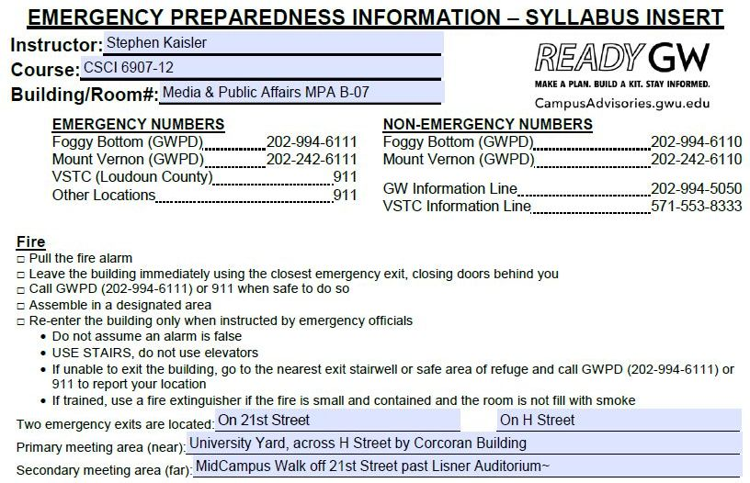
Emergency Preparedness Information
CSCI 6907-13: Big Data and Analytics

Slide 17
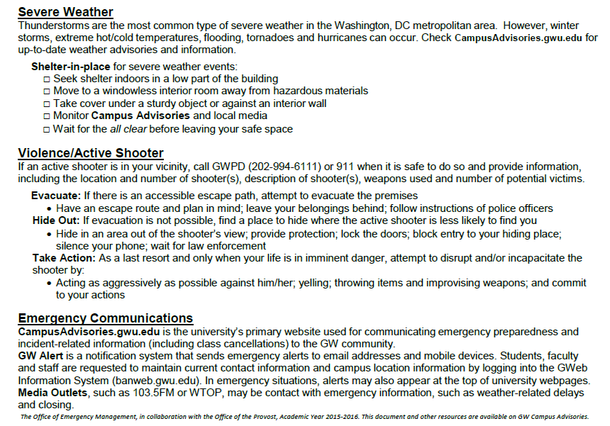
Emergency Preparedness Information
CSCI 6907-13: Big Data and Analytics

Slide 18
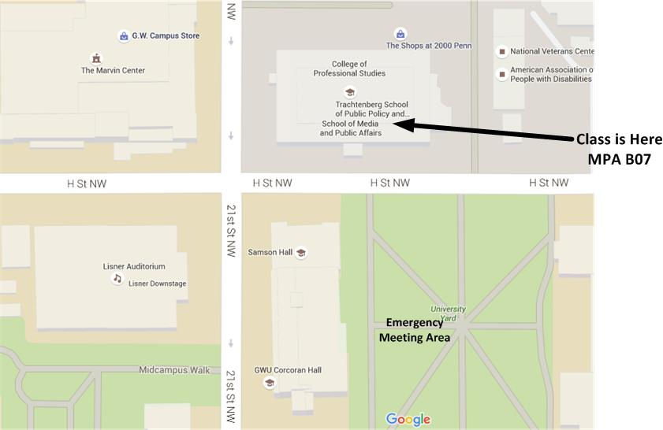
Emergency Meeting Location
NOTE: IN CASE OF EMERGENCY
PROCEED TO NEAR-TERM
OR FAR-TERM LOCATION;
CHECK-IN WITH PROFESSOR
CSCI 6907-13: Big Data and Analytics

Slide 19
Some Readings
S. Kaisler, F. Armour, A. Espinosa, and W. Money. 2013. “Big Data: Issues and Challenges Moving Forward”, 46th Hawaii International Conference on System Sciences, Grand Wailea, Maui, HI
S.Kaisler, F. Armour, A. Espinosa, and W. Money. 2014. “Advanced Analytics: Issues and Challenges”, 47th Hawaii International Conference on System Sciences, Hilton Waikoloa, Big Island, HI
S. Kaisler, F. Armour, W. Money, and A. Espinosa. 2014. “Big Data: Issues and Challenges”, Encyclopedia of Science and Technology, 3rd Edition, IGI Global.
S. Kaisler, F. Armour, A. Espinosa, and W. Money. 2014. “Advanced Analytics: Issues and Challenges”, Encyclopedia of Science and Technology, 3rd Edition, IGI Global.
CSCI 6907-13: Big Data and Analytics

